Slide 1
9s Facts
Backwards one -- teen

Slide 2
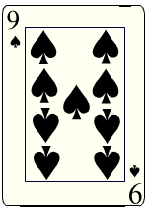
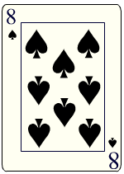
Teen
7
₊
10
+
7

Slide 3
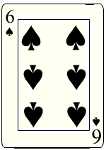
Teen
5
₊
10
+
5

Slide 4
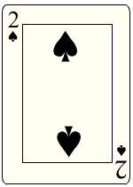
Teen
1
+
10
+
1

Slide 5
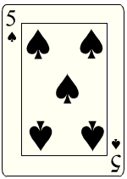
Teen
4
+
10
+
4

Slide 6
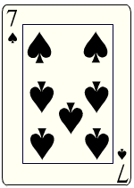
Teen
6
+
+
10
+
6

Slide 7
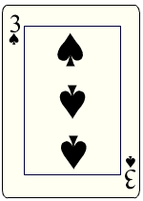
Teen
2
+
10
+
2

Slide 8
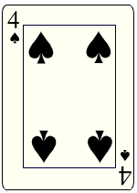
Teen
3
+
10
+
3

Slide 9
9
7
9
+ 4
+ 9
+ 3
13
16
12
9
5
9
+ 8
+ 9
+ 6
17
14
15
More Practice

Slide 10
Return

